Slide 1
Getting Started with the Census Data API in R Using Tidycensus
Catherine Tulley (she/her)
Transportation Planning Data Analyst, SPC
March 9th, 2022 @ PA GeoDev | Virtual Breakout Session 1, Track 3 | 10:15 AM – 11:00 AM
Visit Catherine’s GitHub repo for the exercise files: https://github.com/cjtulley/PA_GeoDev_2022

Slide 2
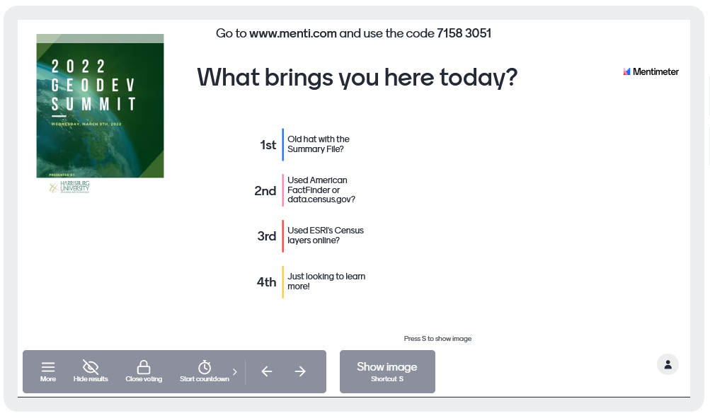
Quick poll
Notes:
https://www.mentimeter.com/s/e26f291b3261f3c0e6d09b7555d60da4/048e63262855/edit - log in with PAMAGIC account.

Slide 3
Today’s Agenda
In this session, we will learn how to query, download and format data from the US Census Bureau’s API (Application Programming Interface) in R, using Dr. Kyle Walker’s ‘tidycensus’ library (plus a few other helper packages).
We will save the results to a CSV, to a formatted Excel file and to a shapefile – all using R!
Pt. 1: Intro to the Census API
The 5 W’s
API Basics
Why Tidycensus?
Pt. 2: Dive into R & Tidycensus
stuff
things
stuff
Pt. 3: Resources + Q&A
Resources
Q&A
Thank You & Contact Info

Slide 4
Pt. 1: Intro to the Census API
Covering the 5 W’s: What, Where, Who, When, & Why (We’ll get to the ‘how’ in a bit…)

Slide 5
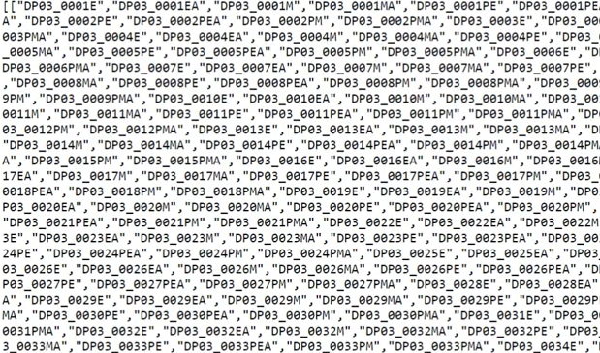
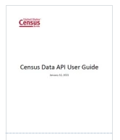

Find out what you need to know…
Always a GOOD IDEA to start with the USCB’s Developers page: https://www.census.gov/data/developers.html
API Gallery – “Is there an API for my dataset?” https://www.census.gov/data/developers/data-sets.html
Refer to the API User Guide: https://www.census.gov/data/developers/guidance.html
Tip: Scroll to the bottom for Video Tutorials & Webinars (great guided intros to using the APIs)
Sign up for your API key ->
Need an API key? Request it here: https://api.census.gov/data/key_signup.html
…to get to what you need: the data!
Notes:
The two or three big Census API endpoints are generally: decennial census, ACS and PUMS data. They are adding more all the time. Other public data agencies (BLS, for example) are following suit with their own APIs.

Slide 6

Where can I find help? Who can help me?
A few suggestions:
Check out good ol’ Stack Exchange! https://stackexchange.com/
Tags: R, Census
Join the US Census Bureau’s Slack Channel (see Resources slides)
Contact the US Census Bureau’s CEDSCI Division (Center for Enterprise Dissemination Services and Consumer Innovation) for API support by email:
cedsci.feedback@census.gov (CB staff generally respond quickly)
ACS Data Users Group Forums:
https://acsdatacommunity.prb.org/

Slide 7




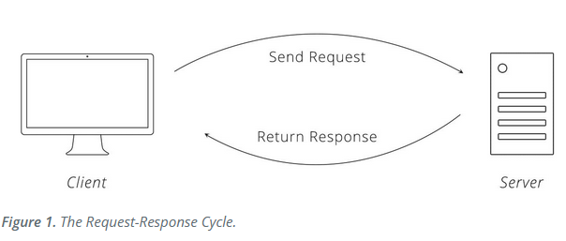



What are we doing & why are we doing it?!
WHEN you need more efficient means to access Census data!
If you’ve ever spent WAY too long trying to download data from AFF (old) or data.census.gov (new)…and then reformatting it for Excel or GIS.
If ESRI’s Living Atlas layers aren’t what you need
If you need to create custom summary tables AND maps to go with them…
Send a query to the API
Get the data returned to you in a format that you can easily slice, dice and manipulate in R…
…and output into any format that you might need, all from the same interface!
CB server
us
+
Graphics by Zapier, R Studio, Walker Data, Microsoft, ESRI, Twitter & Flaticon

Slide 8
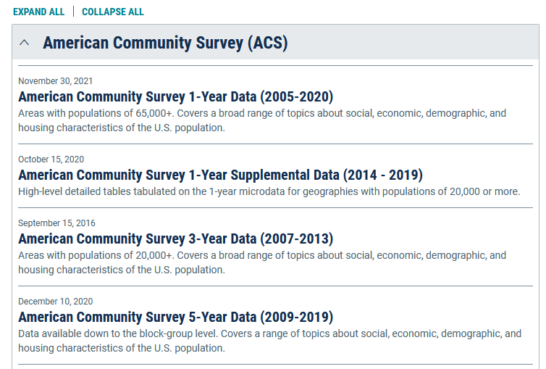
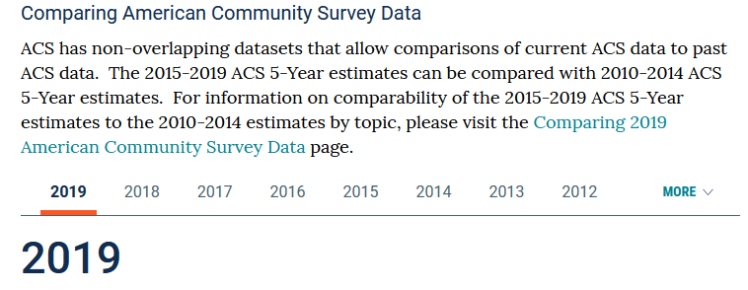
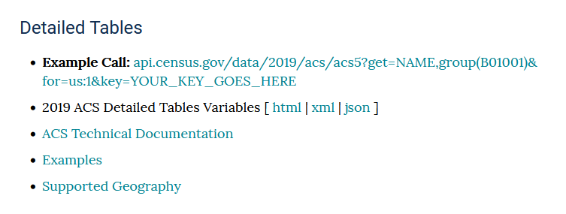
API Basics – How to use the ACS API
We need to understand how it works before we dive into R
Visit: https://www.census.gov/data/developers/data-sets.html
Example: 5-year ACS data -> Click the 5-year link to get here:
https://www.census.gov/data/developers/data-sets/acs-5year.html
Decide which vintage you want to use:
Let’s take a look
Notes:
Example call: this is an example of you interacting with the API directly via your browser. The components include: the API URL, the data year, the endpoint, the command (“GET”) , the variables and your API key.

Slide 9
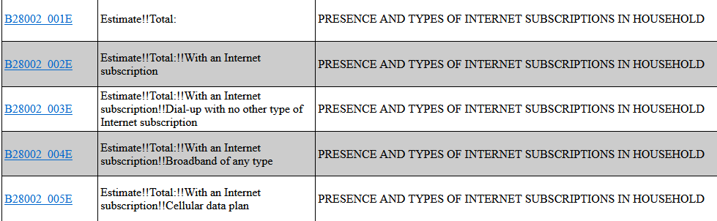
Detailed Tables: Variables
You will need to understand these variables, because we’ll be sending these to the API through Tidycensus.
Variables list: https://api.census.gov/data/2019/acs/acs5/variables.html
Example variables table – let’s say we are looking at broadband availability:
VARIABLE
VARIABLE NAME
TABLE NAME
The “E” stands for Estimate
An “M” would stand for MOE
The first part before the “_” is
the table ID.
TIP: Always review the latest ACS Technical Documentation page to check for updates to the data between vintages (data release years).
link

Slide 10
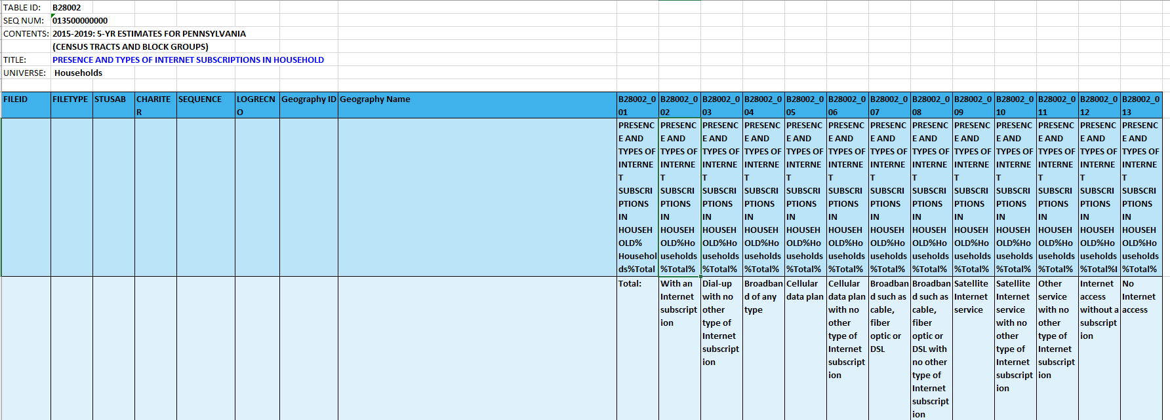
What does this look like from the Summary File? (think “Table Shells”)

Slide 11
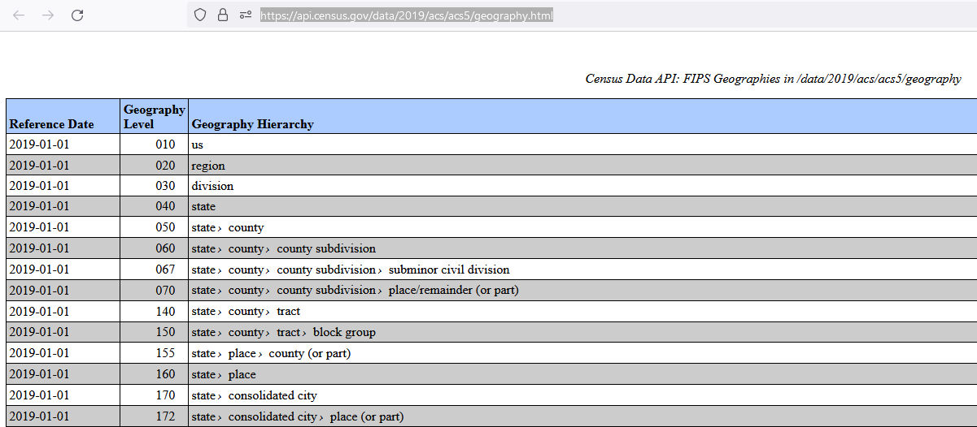
Supported Geographies (think “Sum Levels”)
List of supported geographies for the ACS endpoint: https://api.census.gov/data/2019/acs/acs5/geography.html
We will also supply these to the API through Tidycensus. (You can use the code or the keyword.)

Slide 12
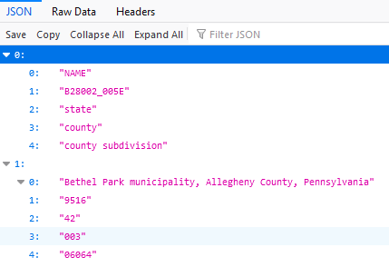
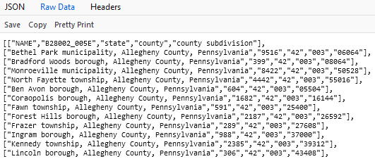
Sample API call with results:
Sample call: view the EXAMPLES page to see different possible combinations: https://api.census.gov/data/2019/acs/acs5/examples.html
https://api.census.gov/data/2019/acs/acs5?get=NAME,B28002_005E&&for=county subdivision:*&in=state:42 & county:003&key=YOUR_KEY_HERE
Data is returned in JSON format (JavaScript Object Notation):

Slide 13


So why use Tidycensus?
Tidycensus takes care of the formatting & API calls for you
“tidycensus is an R package that allows users to interface with the US Census Bureau's decennial Census and five-year American Community APIs and return tidyverse-ready data frames, optionally with simple feature (“SF”) geometry included. tidycensus is designed to help R users get Census data that is pre-prepared for exploration within the tidyverse, and optionally spatially with sf. “
2. What is the Tidyverse?
“The tidyverse is a collection of open source R packages introduced by Hadley Wickham and his team that ‘share an underlying design philosophy, grammar, and data structures’ of tidy data. “
Graphics by Staples and the maintainers of the Tidyverse
Notes:
So what does all of that mean? It means that this package a.) understands how to ask for the data, b) gets it in a nicely-formatted way and c) is optimized to allow you create spatial files with it.

Slide 14
Pt. 2: Dive into R & Tidycensus
Now for the fun part!

Slide 15
Let’s move into R
Please open your RStudio Desktop or log into RStudio Cloud
Navigate to GitHub & copy the R code into a new script file:
https://github.com/cjtulley/PA_GeoDev_2022

Slide 16
Pt. 3: Resources + Q&A
Where you can learn more

Slide 17



Resources
Kyle Walker’s website:
eBook: “Analyzing US Census Data: Methods, Maps and Models in R” https://walker-data.com/census-r/index.html
Tidycensus: https://walker-data.com/tidycensus/
Tigris: https://github.com/walkerke/tigris
Website: https://walker-data.com/
TIP: Join Walker’s email list or follow him on social media to learn about his upcoming workshops and other updates.

Slide 18

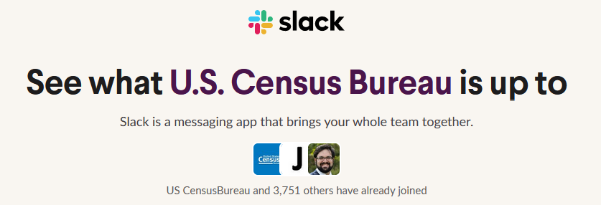
Resources
2) U.S. Census Bureau Developer resources:
Slack channel: https://uscensusbureau.slack.com
3) Developers landing page:
https://www.census.gov/data/developers.html
Sign up for the Developers email list
Click here to join the Slack channel: https://bit.ly/3MDefaK
TIP: Check the Slack channel for assistance - your fellow users are available to help you!

Slide 19

Resources
4) Zapier: An Introduction to APIs
Free e-course: https://zapier.com/learn/apis/
PDF available
Table of Contents:
Chapter 1: Introduction
Chapter 2: Protocols
Chapter 3: Data Formats
Chapter 4: Authentication, Part 1
Chapter 5: Authentication, Part 2
Chapter 6: API Design
Chapter 7: Real-Time Communication
Chapter 8: Implementation
Click here t join the Slack channel: https://bit.ly/3MDefaK

Slide 20

Thank you!
Catherine Tulley (she/her)
Transportation Planning Data Analyst
Southwestern Pennsylvania Commission
412-391-5590 | https://www.spcregion.org
ctulley@spcregion.org
GitHub: https://github.com/cjtulley

